Slide 1

of
Game Cards
October 9th, 2018
Team WildCard
Thuan Le (PO) | Kalyn Williams | Thanut (Art) Parkeenvincha (SM)

Slide 2
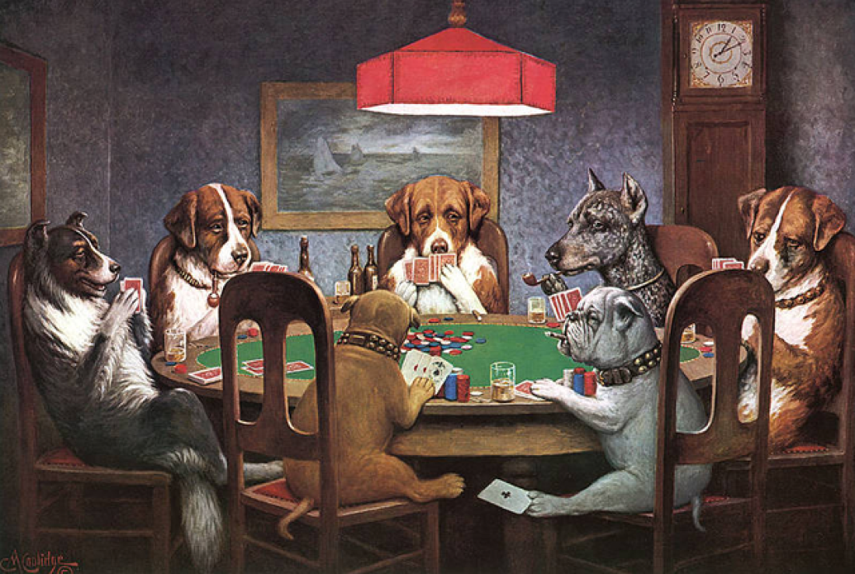
High Level Overview
Implement two card games where the user can play with the dealer.
Furthermore, we strongly hope to implement multiplayer where the user can host the game via a peer-to-peer network to play with friends.

Slide 3
Sprint 1:
As a team member, I want to become proficient in Unity (C#) by learning together at the same pace.
As a user, I want to have a functional user interface that allows me able to pick a card game to play and modify settings.
As a team member, I want to be able to communicate with my team in an organized and efficient matter.

Slide 4
Sprint 2:
As a user, I want to have an engaging original single player card game called Chance.
As a user, I want to play Chance bug-free and with additional gameplay features, such as the swap mechanic.
As a user, I want to experience Chance in a multiplayer setting with friends.

Slide 5
Sprint 3:
As a user, I want to play the classic game Blackjack.
As a user, I want to play Blackjack bug-free
As a user, I want to experience Blackjack in a multiplayer setting with friends.

Slide 6
Sprint 4:
As a user, I want a full game experience that includes music, sound, and other additional effects.

Slide 7
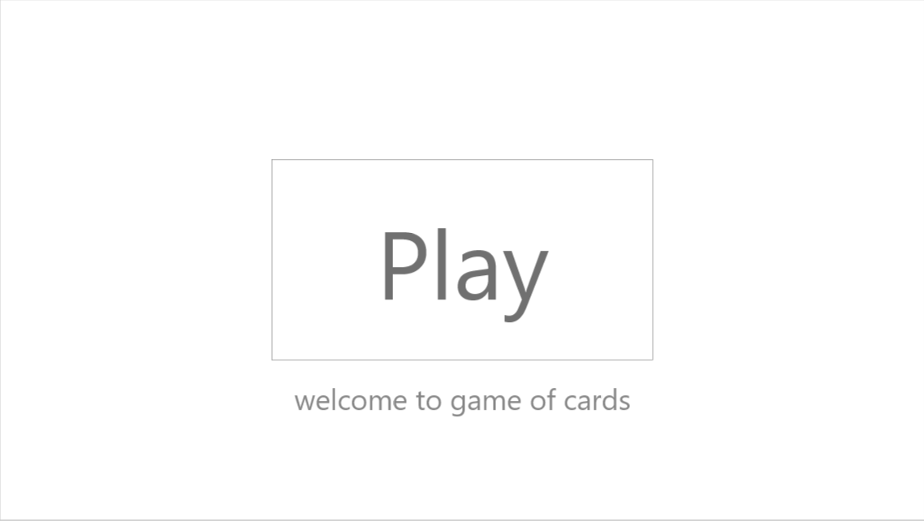
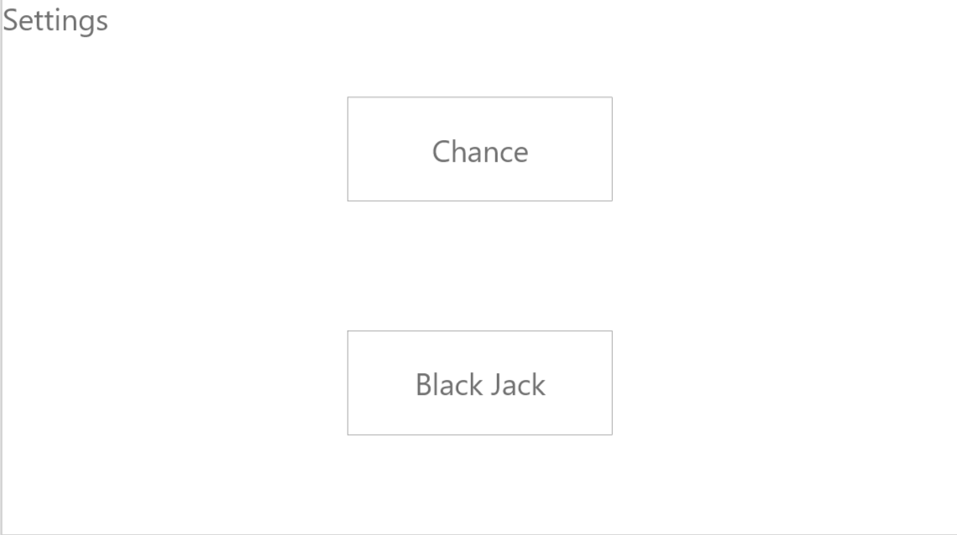
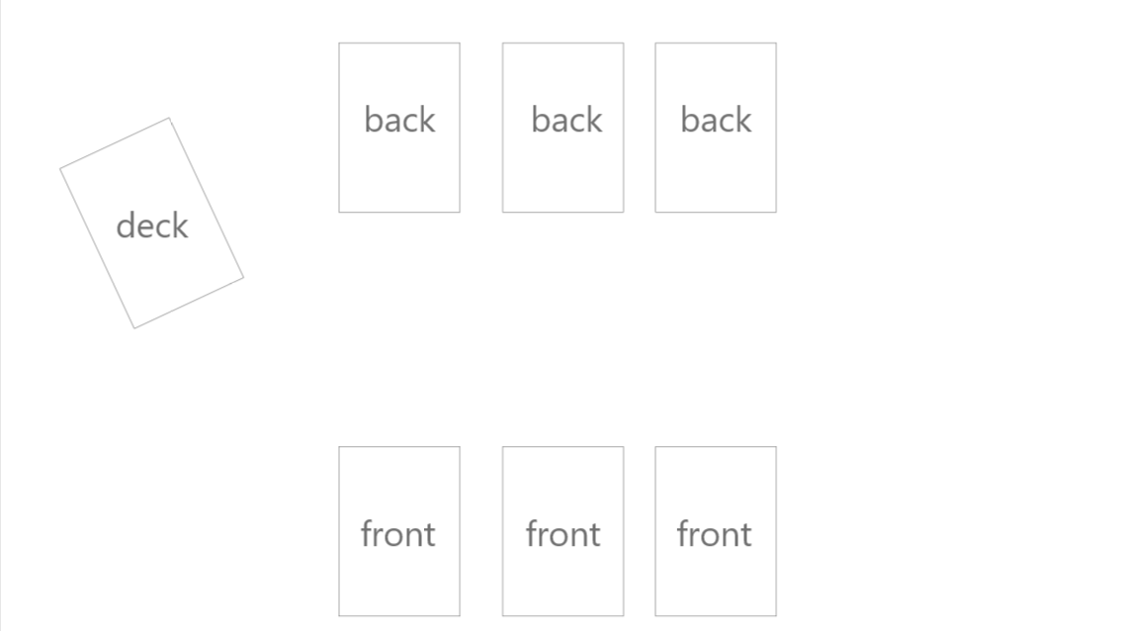
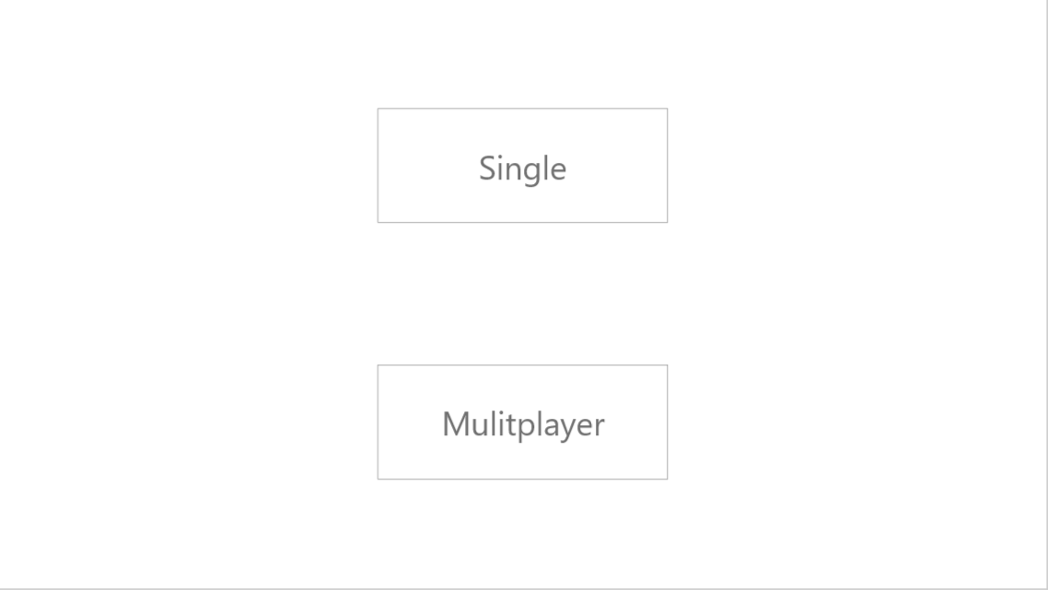
Architecture

Slide 8


Technologies

Slide 9
Challenges
There isn’t a need for online card games.
Learning Unity.
Not many people are passionate about creating card games.

